Slide 1





Musical micro:bit
Teacher lesson guide
Lesson 3

Slide 2
Learning objectives:
To analyse and modify algorithms.
To identify patterns in algorithms.
To write algorithms using repetition and selection.

Slide 3
Analysing algorithms
Look at the algorithm. What statements can you make about it?
If this algorithm was followed, what would you see happening?
FOREVER
IF I wave
THEN pat head
IF I point to the ceiling
THEN tap shoulders
IF I point to the window
THEN turn around
IF I point to the floor
THEN jump

Slide 4
Following algorithms
FOREVER
IF I wave
THEN pat head
IF I point to the ceiling
THEN tap shoulders
IF I point to the window
THEN turn around
IF I point to the floor
THEN jump

Slide 5
Modifying algorithms
Can you add further examples of selection to your algorithm?
Use the patterns in the algorithm to help with the structure.
FOREVER
IF I wave
THEN pat head
IF I point to the ceiling
THEN tap shoulders
IF I point to the window
THEN turn around
IF I point to the floor
THEN jump

Slide 6
Debugging algorithms
The goal of the algorithm was to get a person to carry out an action once when the gesture was made.
Does this algorithm reach this goal?
How could we change the algorithm so it does met the goal?
FOREVER
IF I wave
THEN pat head
IF I point to the ceiling
THEN tap shoulders
IF I point to the window
THEN turn around
IF I point to the floor
THEN jump
Notes:
Pupils could modify the ‘then’ statement so that each reads Then action once - Then turn around once

Slide 7
Conducting an orchestra
What gestures does the conductor make?
How do the orchestra respond to these gestures?
Write an algorithm for one on the conductor’s gestures.
https://mbit.io/lessons_music_video
Notes:
Example algorithm
Forever
If the conductor waves hands high in the air
Then play faster

Slide 8
Conducting the class
We are going to conduct the class to play musical phrases.
Write an algorithm so your classmates know what note to play when you make a certain gesture.
Plan your gestures out using the planning sheet then write your algorithm.
Use the patterns in the algorithm from earlier to support you.
What words do you think will be used in the algorithm?
Notes:
Keywords: forever, if, then, play, note, once

Slide 9
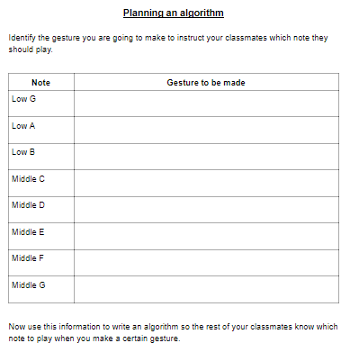
Planning your gestures
Notes:
Keywords: forever, if, then, play, note, once

Slide 10
Conducting the class
Display your algorithm to the class.
Conduct the class so they play one of your musical phrases from lesson one.
Orchestra, use the algorithm to identify which note to play when the conductor makes a certain gesture.

Slide 11
Evaluating the algorithms
Was the algorithm easy to follow?
Was the pattern of the other algorithm used?
Did you understand all the language that was used?
Did you have to make any assumptions because of a lack of clarity?
Notes:
Pupils decide if the language used was simple and straightforward
Pupils identify is indentation is used to show the action that would be taken if a condition was met
Pupils identify if there was any language or phrases they didn’t understanding - use of slang terms for dances may restrict understanding for some pupils.
Pupils identify if they had to carry out actions because they knew they were supposed to do them even though it wasn’t mentioned in the algorithm. Most commonly pupils forget to start with forever in this case pupils only check once if the condition is being met. They also forget to put once in to identify that the note should be played once and not continuously until another gesture is made.

Slide 12
Learning objectives revisited:
To analyse and modify algorithms
To identify patterns in algorithms
To write algorithms using repetition and selection

Slide 13
FOREVER
IF I wave
THEN pat head
IF I point to the ceiling
THEN tap shoulders
IF I point to the window
THEN turn around
IF I point to the floor
THEN jump

Slide 14
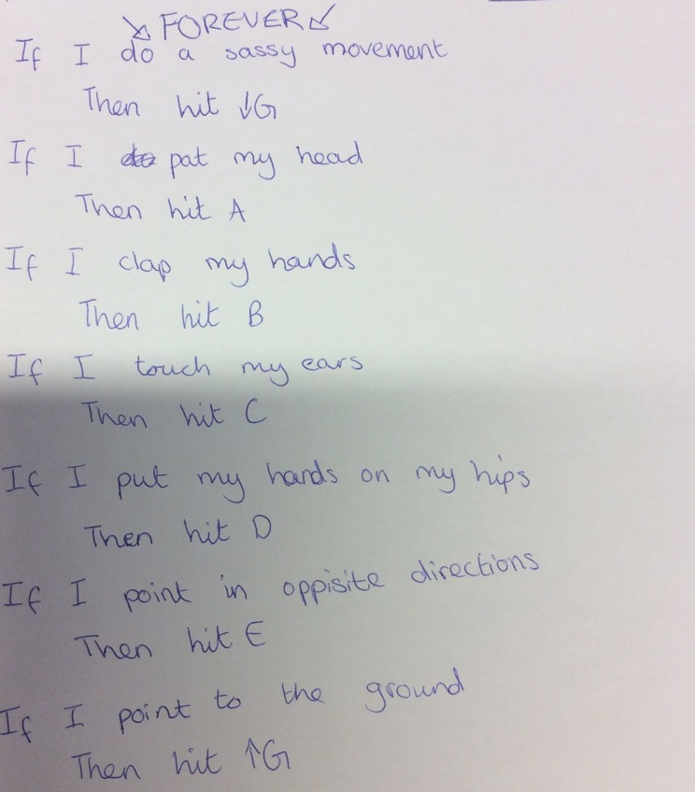
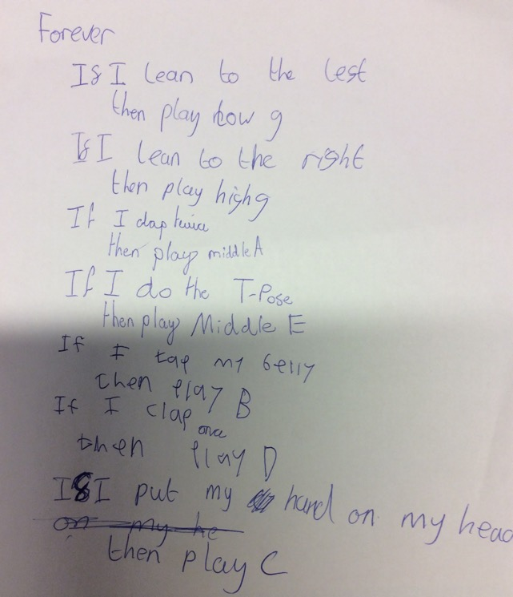
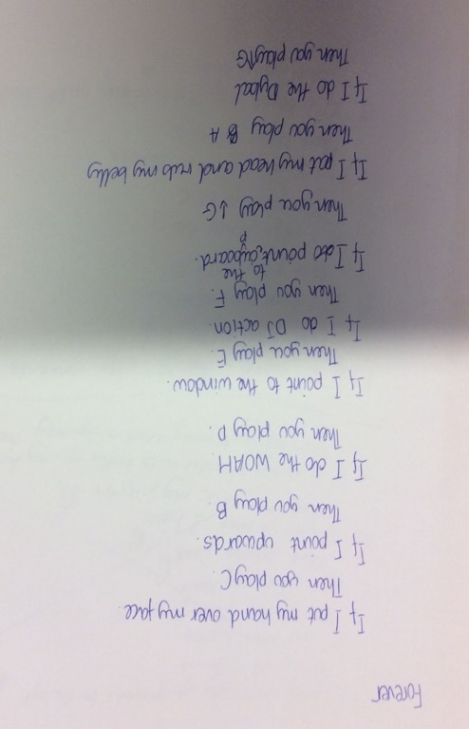
Example algorithms

